Slide 1
Research Note-taking and APA Style
Tina Evans, MAT
February 2015

Slide 2
Example Driving Question
What is a natural solution to curbing pollution caused by eutrophication in the French Broad River in Asheville, North Carolina?
(runoff from fertilized lawns, agricultural fields and sewage treatment plants)

Slide 3
Most Important: Finding Credible Resources 1) Go to Buncombe County Schools 2) Select Nesbitt Discovery Academy

Slide 4
Nesbitt Discovery Academy Website
Click on Academics
Scroll down & click on resources, then click on the link.

Slide 5
Finding a credible resource—good options (see below)

Slide 6
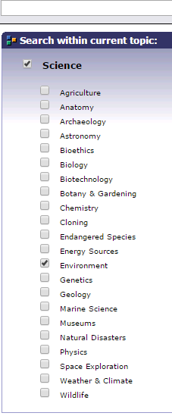
Narrow your search
Example: NC Wise Owl
High School Zone
Student Research
Password: wiseowl
Next, click on Science
Then, click on Environment

Slide 7
Narrow your search
Search bar: Water Pollution Solutions
Narrow down to an article

Slide 8
Create a new page that is titled Annotated Bibliography

Slide 9
Determine citation information BEFORE taking notes.
Helps to eliminate plagiarism if you cite your sources as you do your research
Saves time later when you’re in the thinking/writing mode
Go to: www.citationmachine.net
Choose APA for Science, Engineering and Psychology
Choose MLA for English, History, Humanities

Slide 10
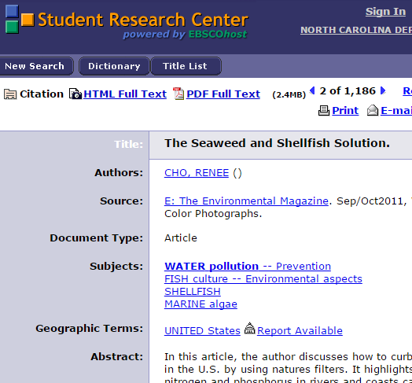
Choose your source type
Article from NCWise Owl

Slide 11
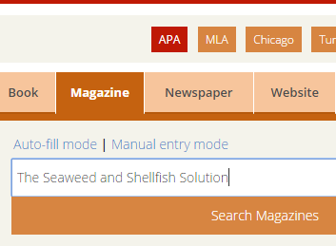
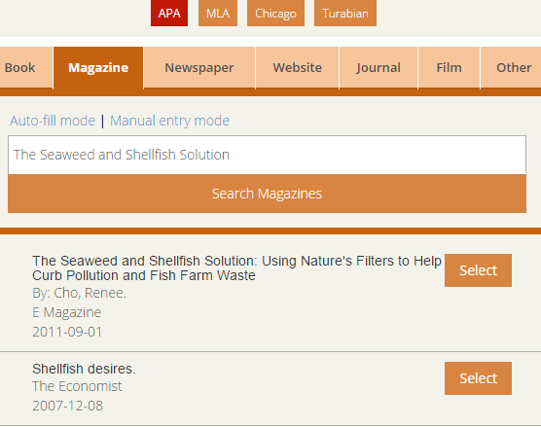
Fill in the blanks in Citation Machine

Slide 12
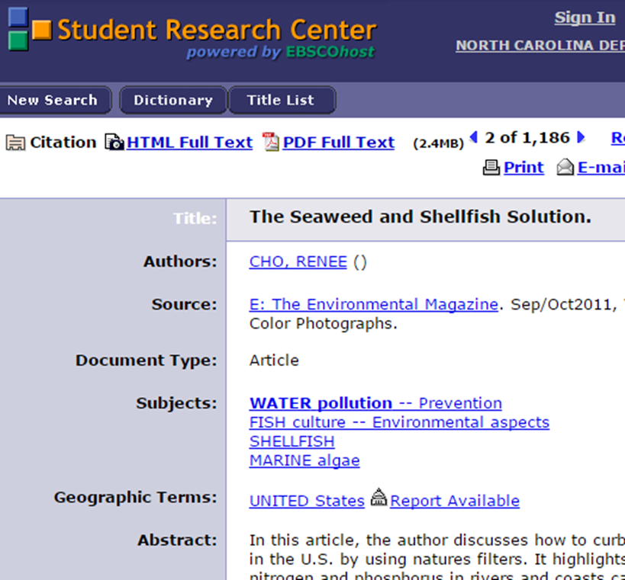
Check to make sure all of the blanks are filled in; add or change information

Slide 13
Click “Make Citation” and then cut and paste into your Annotated Bibliography

Slide 14
Annotated Bibliography
The Annotated Bibliography is a separate page
Double-space
Alphabetize your list
It should have several sentences summarizing the main points or ideas found in the item. It should then include your own statement evaluating the quality of the item and/or relating the item to your own research topic.
(https://www.bethel.edu/library/research/apa-annobib-sixth.pdf)

Slide 15
Determine your in-text citation
Click on Parenthetical
Fill in the blanks

Slide 16
Your in-text citation appears!

Slide 17
APA Style
As the name author–date system implies, APA Style in-text citations include the author and date, either both inside parentheses or with the author names in running text and the date in parentheses. Here are two examples:
After the intervention, children increased in the number of books read per week (Smith & Wexwood, 2010).
Smith and Wexwood (2010) reported that after the intervention, children increased in the number of books read per week.
http://blog.apastyle.org/apastyle/2011/01/writing-in-text-citations-in-apa-style.html

Slide 18
Create a table for taking Cornell notes
Main Idea | Details | Source/Citation

Slide 19
Cut and paste information you want to use into your table—be sure to include your in-text citation!

Slide 20
Each point is a separate bullet point (it’s easier once you start writing)
Main Idea | Details | Source/Citation
Chemical process | “Nitrogen and phosphorus exist in organic (plant and animal residue) and inorganic (mineralized) forms” (Cho, 2011). “As shellfish filter water, they remove organic nutrients, while seaweeds take up inorganic nutrients” (Cho, 2011). | Cho, R. (2011, September 1). The Seaweed and Shellfish Solution: Using Nature's Filters to Help Curb Pollution and Fish Farm Waste. E: The Environmental Magazine, 12-14.

Slide 21
OPTIONS
Take one page of notes per article
Or take notes based on the main idea/topic and add different sources to the same page

Slide 22
Other questions about APA formatting? Visit the site below:
http://blog.apastyle.org/apastyle/apa-style-experts.html
Common question—what if the article doesn’t have an author?
Example:
All 33 Chile miners freed in flawless rescue. (2010, October 13). Retrieved from http://www.msnbc.msn.com/id/39625809/ns/world_news-americas/
Cite in text the first few words of the reference list entry (usually the title) and the year. Use double quotation marks around the title or abbreviated title: ("All 33 Chile Miners," 2010).

Slide 23
Happy researching!

